Slide 1
Terms and Words to Know and Love #6

Slide 2
Literary Term to Know and Love
Pun: a play on words, often achieved through the use of words with similar sounds but different meanings. (homonyms)

Slide 3
Literary Term to Know and Love
Pun :
From Act One Scene II of Hamlet:
Claudius: How is it that the clouds still hang on you?
Hamlet: No, my Lord, I’m too much in the sun.

Slide 4
Literary Term to Know and Love
Pun : Hamlet is punning on the words “sun” and “son”. His cloudiness of temper-ament is due to his feelings of grief and obligation to his dead father AND to his disgust at being considered a son by the new king. He feels too much OF a “son”, so he responds to the accusation of “cloudiness” by saying he is too much IN the “sun.”

Slide 5
Literary Term to Know and Love
Anaphora: the repetition of words or phrases at the beginning of consecutive lines or sentences. Speakers use anaphora to emphasize ideas they deem important .

Slide 6
Literary Term to Know and Love
Anaphora:
In Act One Scene 2 ,Claudius tells Hamlet that his persistent mourning for his father :
“'tis a fault to heaven,
A fault against the dead,
a fault to nature…”

Slide 7
Literary Term to Know and Love
Syllepsis: A construction in which one word is used in two different senses.
Gertrude: Thou know'st 'tis common; all that lives must die/Passing through nature to eternity.
Hamlet: Ay, madam, it is common.
Common is used first in the sense of “common knowledge” then, by Hamlet, to mean “low-class or without class.”

Slide 8
Words to Know and Love
filial : adj. of, relating to, or befitting a son or daughter
-from Latin filius, meaning "son," and filia, meaning “daughter."
The word implies duty, suggesting something owed to a parent by a child.

Slide 9
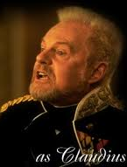
Words to Know and Love
filial : adj. Claudius [to Hamlet]:
“…But you must know,
your father lost a father;
That father lost, lost his,
and the survivor bound
In filial obligation for some term
To do obsequious sorrow.”

Slide 10
Words to Know and Love
Obsequious: adj.: exhibiting a fawning (flattering) attentiveness
-from the Latin root sequi,
meaning "to follow."
The word implies an exaggerated deference of manner . For instance, waiters who are obsequious in the presence of celebrities.

Slide 11
Words to Know and Love
Jocund: adj.
- marked by or suggestive of high spirits and lively mirthfulness.
The word comes from "jucundus," a Latin word meaning "agreeable" or "delightful."

Slide 12
Words to Know and Love
Jocund: adj.
Claudius [to Gertrude] :Madam, come;
This gentle and unforced accord of Hamlet
Sits smiling to my heart: in grace whereof,
No jocund health that Denmark drinks today,
But the great cannon to the clouds shall tell.

Slide 13
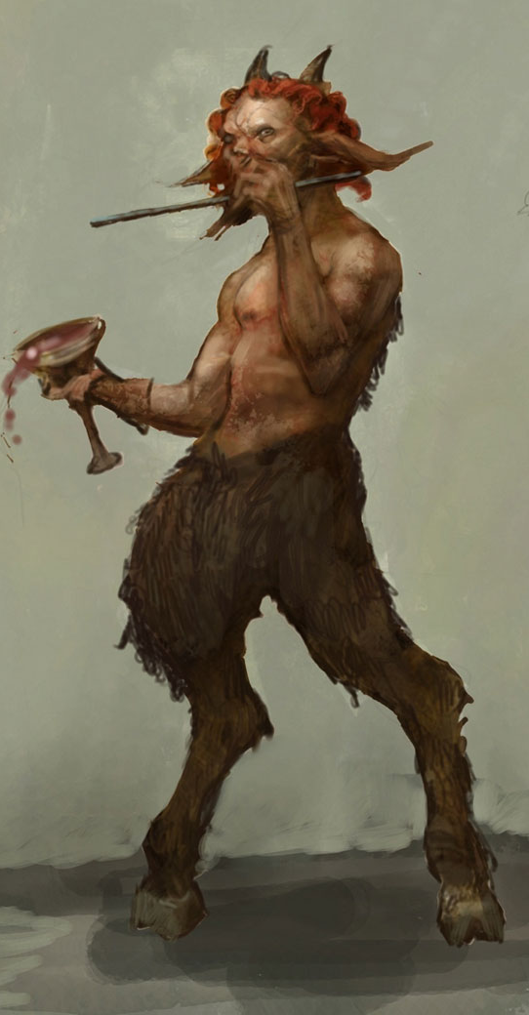
Words to Know and Love
Satyr: noun
1. One of the forest gods in Greek mythology who have the faces and bodies of men, and the ears, legs, and tails of goats .
2. A lecherous man.

Slide 14
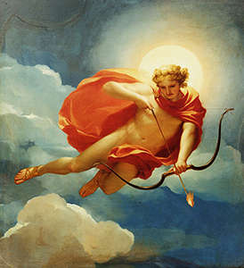
Words to Know and Love
Satyr: noun
Hamlet [describing his father] :
So excellent a king, that was to this [Claudius]
Hyperion (Greek god of the sun) to a satyr.

Slide 15
Words to Know and Love
Galled : adj.
1. angered or annoyed
2. irritated or inflamed
Hamlet: Within a month,
Ere yet the salt of most unrighteous tears
Had left the flushing in her galled eyes,
she married. - Act One, Scene 2

Slide 16
Words to Know and Love
Dexterity: noun
1. the ability to use the hands skillfully
2. the ability to easily move gracefully
3. clever skill : the ability to think and act quickly and cleverly
Hamlet: O, most wicked speed, to post
With such dexterity to incestuous sheets!
-Act One, Scene 2

