Slide 1
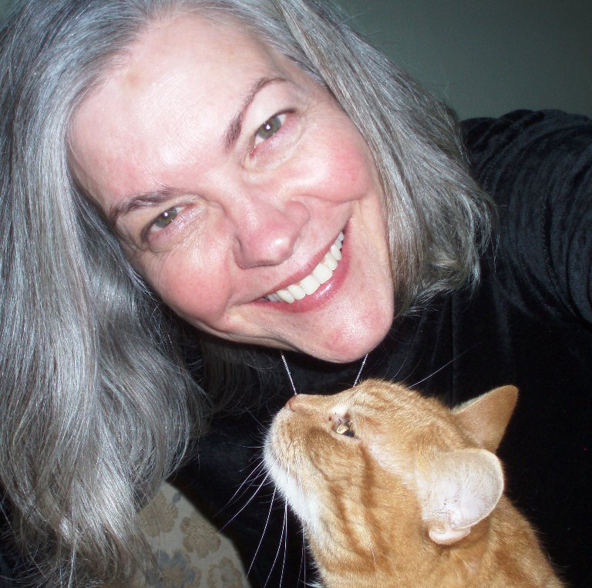
The Tragedy of Prince Hamlet
http://goo.gl/forms/FID9LLio1h
William Shakespeare

Slide 2
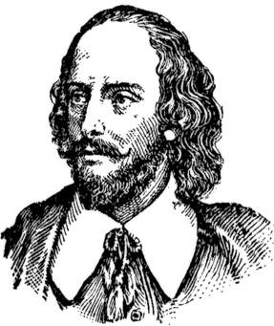
The Tragedy of Hamlet
William Shakespeare wrote The Tragedy of Hamlet, Prince of Denmark, around 1601, during the final years of the reign of Queen Elizabeth I. It is considered by many to be the best play ever written.

Slide 3
The Tragedy of Prince Hamlet
Hamlet is based on a Norse legend composed by Saxo Grammaticus in Latin around 1200.
In Saxo's version, King Rorik of the Danes places his trust in two brothers, Orvendil and Fengi. The brothers are appointed to rule over Jutland.

Slide 4
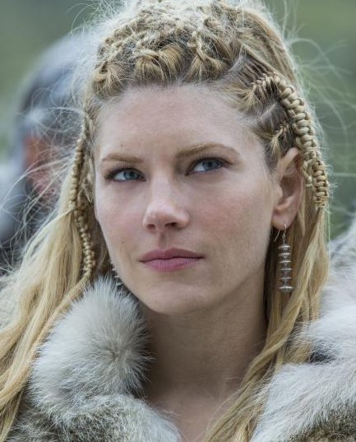
The Tragedy of Prince Hamlet
Orvendil weds the King's beautiful daughter, Geruth. They have a son, Amleth. But Fengi, lusting after Orvendil's new bride and longing to become the sole ruler of Jutland, kills his brother, marries Geruth, and declares himself King over the land.

Slide 5
The Tragedy of Prince Hamlet
Young Amleth is desperately afraid, and feigns madness to keep from getting murdered. He bides his time until he is old enough to take revenge against his uncle and becomes the new and rightful King of Jutland.

Slide 6
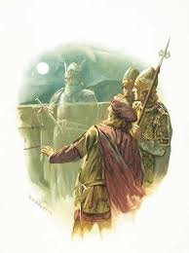
The Tragedy of Prince Hamlet
Shakespeare used the earlier play based on this Norse legend by Thomas Kyd, known as the Ur-Hamlet.
All we know about the Ur-Hamlet is that it was performed on the London stage, that it was a tragedy, and that there was a character in the play named Hamlet, and a ghost who cried "Hamlet, revenge!"

Slide 7
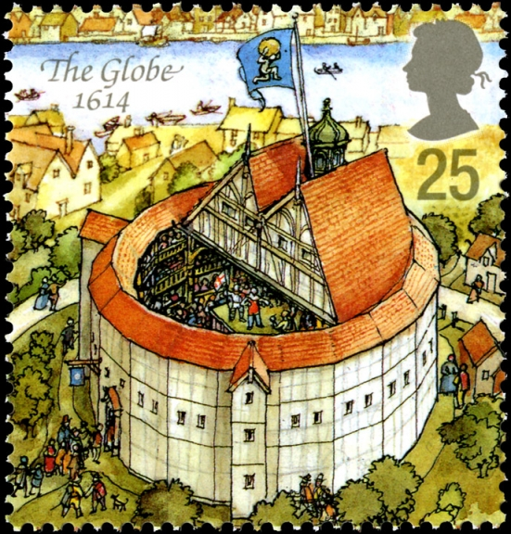
The Tragedy of Prince Hamlet
When you speak these lines, you are speaking lines from what most scholars consider the greatest play ever written.
For that reason, you will earn 25 extra credit points for all passages you memorize and recite in class.
I will also offer additional extra credit for longer passages from time to time.

Slide 8
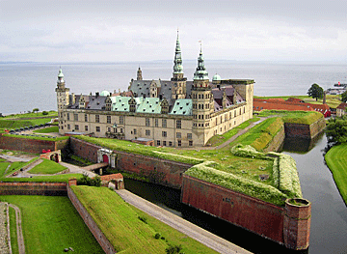
The Tragedy of Prince Hamlet
Act I Scene I summary
Setting:
The battlements of Elsinore castle, Denmark.
Characters: Bernardo and Francisco, two sentinels
Horatio (Hamlet's true friend; a scholar)
Marcellus, also a sentinel.

Slide 9
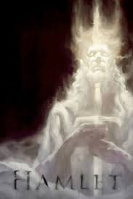
The Tragedy of Prince Hamlet
Guards Marcellus and Bernardo tell a skeptical Horatio that a ghost has appeared on the battlements on two consecutive nights.

Slide 10
The Tragedy of Prince Hamlet
Then the ghost appears on cue in the form of the recently deceased King of Denmark, in full armor as when he defeated the King of Norway and on another occasion he defeated the Poles.

Slide 11
The Tragedy of Prince Hamlet
Horatio attempts to talk to the ghost, but it seems offended and leaves. Horatio suspects that the ghost’s appearance foreshadows disaster for Denmark. Marcellus asks why the need for the intense watch and the preparations for war.

Slide 12
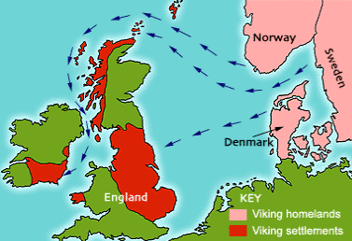
The Tragedy of Prince Hamlet
Horatio explains that old Hamlet was challenged to combat by old Fortinbras, then King of Norway, and killed him. Consequently, old Hamlet won lands formerly conquered by old Fortinbras.

Slide 13
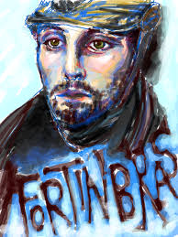
The Tragedy of Prince Hamlet
The Norwegian kingdom subsequently went to Fortinbras' brother, called only "Norway“ here. But young Fortinbras, son of the slain king, has raised an army to recover his lost inheritance and seems poised to invade Denmark.

Slide 14
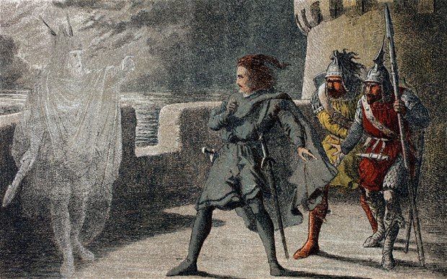
The Tragedy of Prince Hamlet
The ghost reappears, and Horatio asks it to tell them what it knows of their country's fate. But the cock crows and the ghost leaves. As dawn breaks, Horatio suggests they tell young Hamlet about the ghost, hoping the ghost will speak to him.

Slide 15
The Tragedy of Prince Hamlet
Today we will begin our study of Hamlet with the help of an annotated production of the play. I wonderful woman I have named Lesley (after my wife) provides the commentary. Please make note of 5 fun facts about Shakespeare or Hamlet. I will use them to make our first surprise quiz.

Slide 16
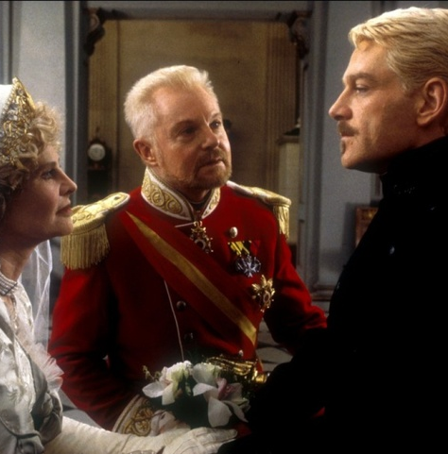
The Tragedy of Prince Hamlet
Act I Scene
II summary
Setting:
The castle.
Characters:
Claudius (brother of old Hamlet; now King); Gertrude (former wife of old Hamlet; bride of Claudius; Hamlet’s mother); Prince Hamlet

Slide 17
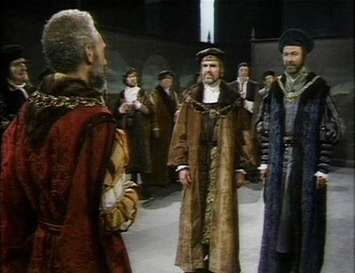
The Tragedy of Prince Hamlet
Cornelius and Voltimand (ambassadors)

Slide 18
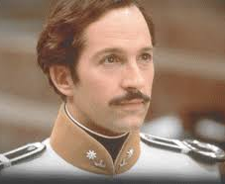
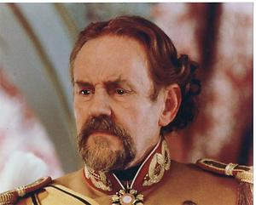
The Tragedy of Prince Hamlet
;
Polonius
(father of Laertes and Ophelia;
advisor and ally of Claudius)
Laertes (son of Polonius;
brother of Ophelia)

Slide 19
The Tragedy of Prince Hamlet
1. Claudius tells the court how his sorrow for his brother's death is mixed with his joy at marrying Gertrude, and thanks the courtiers for approving of his marriage.

Slide 20
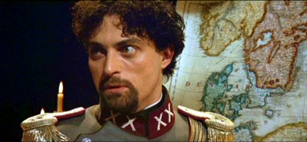
The Tragedy of Prince Hamlet
Claudius tells the court that Fortinbras' has demanded the return of the lands lost by his father because he thinks Denmark is weakened by old Hamlet’s death. Fortinbras is a foil for Hamlet.

Slide 21
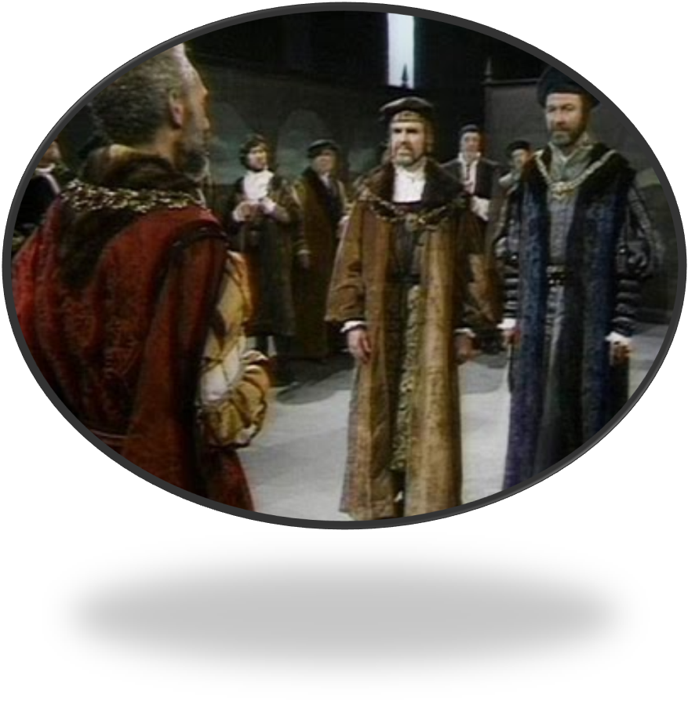
The Tragedy of Prince Hamlet
.Claudius has written to the King of Norway asking him to restrain Fortinbras, and sends Cornelius and Voltimand on this diplomatic mission.

Slide 22
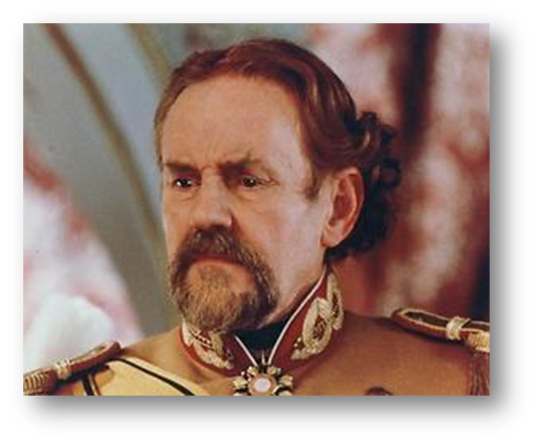
The Tragedy of Prince Hamlet
Claudius then asks young Laertes, the son of Polonius, what his plans are. While doing so, he praises Polonius highly, suggesting that the courtier may have played a critical role in bringing him to the throne.

Slide 23
The Tragedy of Prince Hamlet
Laertes, who has come to attend the coronation, wishes to return to France. The King grants his wish. Laertes is a foil to Hamlet.

Slide 24
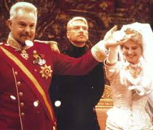
The Tragedy of Prince Hamlet
4. Claudius and Gertrude ask Hamlet to stop mourning the death of his father. The King rebukes him for continuing to mourn and tells him he does not want him to return to his studies in Wittenberg, a request echoed by Gertrude. Hamlet consents to obey HER. Claudius is happy with Hamlet’s apparent obedience.

Slide 25
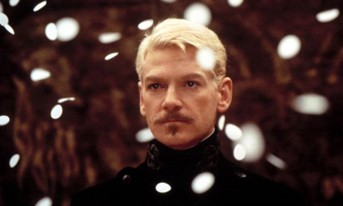
The Tragedy of Prince Hamlet
5. Left alone, Hamlet expresses his nearly suicidal anguish caused by his father’s death and his mother’s marriage to Claudius. ("Frailty, thy name is woman") ("O, most wicked speed, to post/With such dexterity to incestuous sheets!")

Slide 26
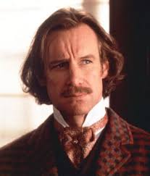
The Tragedy of Prince Hamlet
Horatio arrives at court with Marcellus and Bernardo and tells Hamlet that they’ve seen the ghost of his dead father. Hamlet resolves to see for himself and asks them to keep the matter secret. He suspects that a crime has been committed and that the ghost may have come to reveal the “foul deeds”.

Slide 27
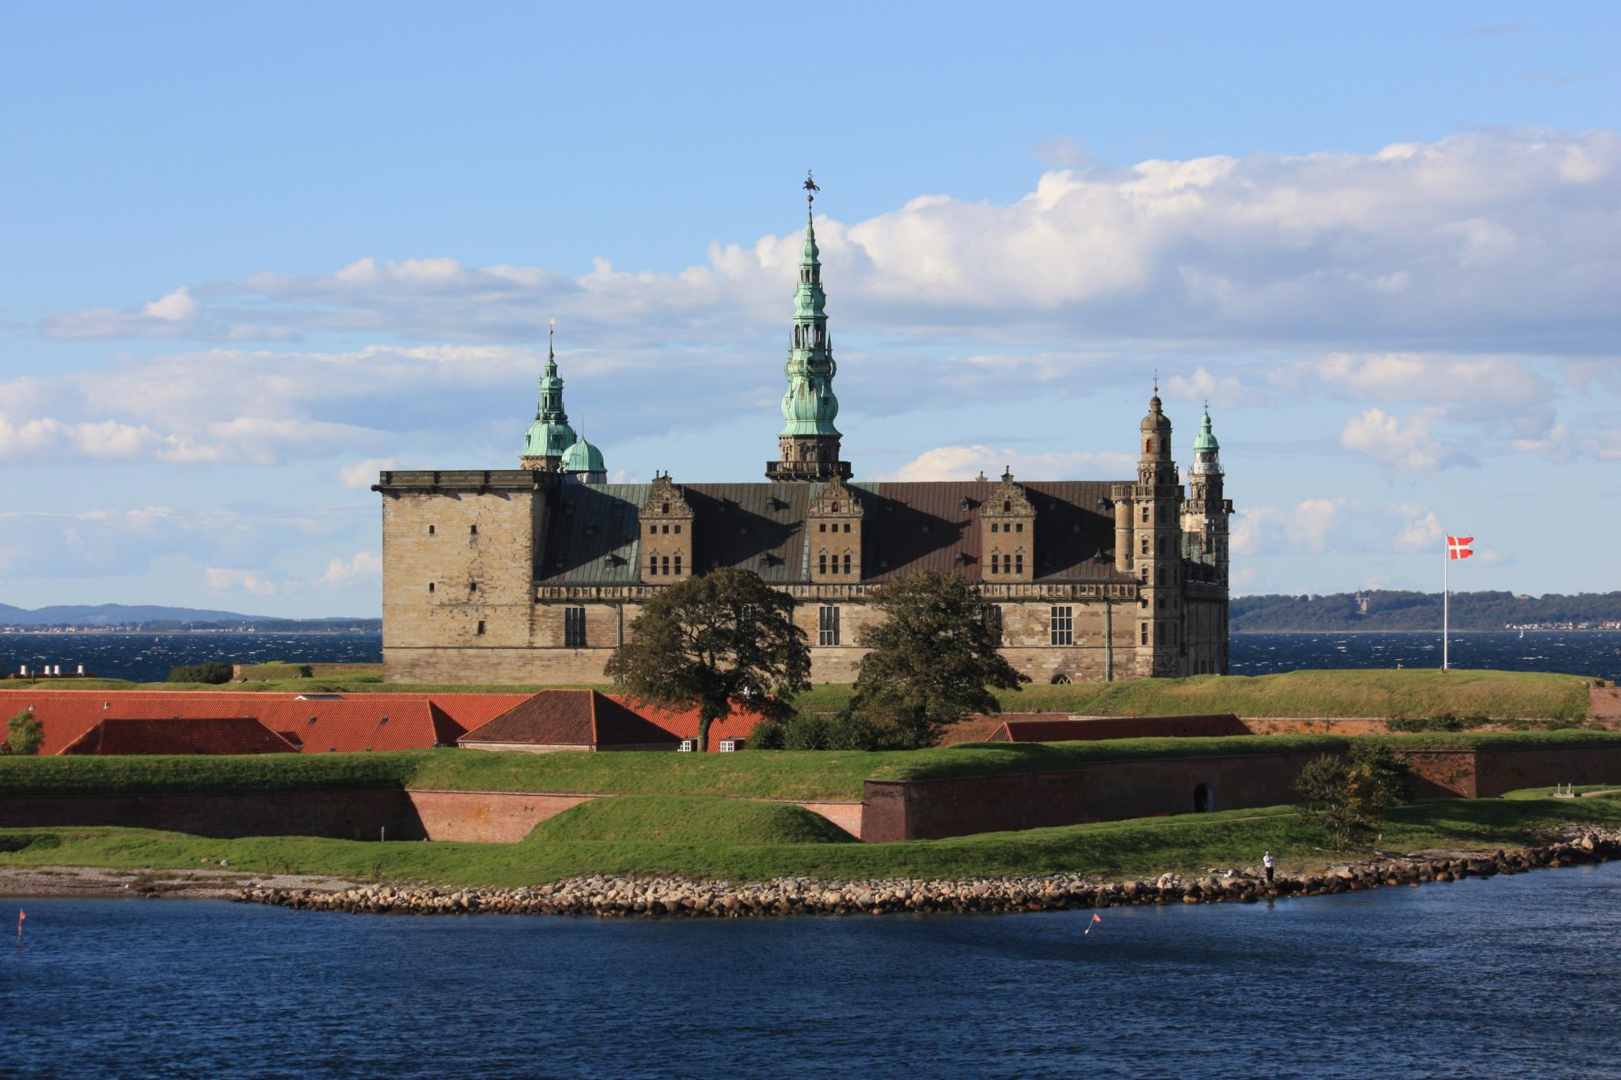
The Tragedy of Prince Hamlet
Act I Scene III
Setting: A Room in Polonius’ House or a Dock near Elsinor Castle
Characters: Laertes and his sister, Ophelia; their father Polonius

Slide 28
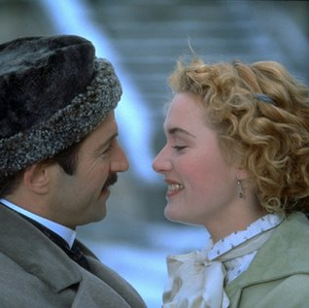
The Tragedy of Prince Hamlet
Act I Scene III
1. Laertes tells Ophelia to consider Hamlet's attentions to be mere infatuation: "the perfume and suppliance (diversion) of a minute." He also says that even if Hamlet loves her now, as a prince, "his will is not his own“. He warns her not to succumb to his “unmastered importunity,” because her honor and, perhaps more importantly, his own honor is at stake.

Slide 29
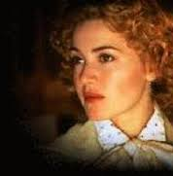
The Tragedy of Prince Hamlet
Act I Scene III
2. Ophelia graciously accepts Laertes’ advice, though she warns her brother not to be a hypocrite by showing her “the steep and thorny way to heaven,” while he walks the “primrose path of dalliance.”

Slide 30
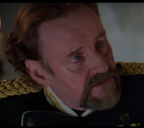
The Tragedy of Prince Hamlet
Act I Scene III
Polonius arrives and gives Laertes some fatherly advice (a blend of foolishness, craftiness, fatherly concern, and wisdom) including "This above all: to thine own self be true,/And it must follow, as the night the day,/Thou canst not then be false to any man."

Slide 31
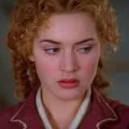
The Tragedy of Prince Hamlet
Act I Scene III
Polonius also asks Ophelia about her relationship with Hamlet. She says he has "made many tenders of affection to me" and "importuned me with love in an honorable fashion". But Polonius is concerned with her chastity and his own reputation. He orders her not to see or communicate with Hamlet. Ophelia reluctantly says she will obey her father.

Slide 32
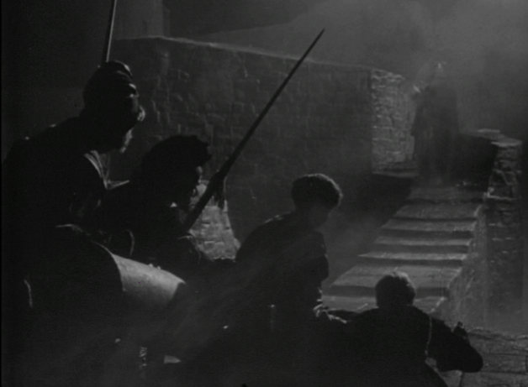
The Tragedy of Prince Hamlet
Act I Scenes IV and V
Enter
Setting: The bitterly cold battlements of Elsinor Castle.
“The air bites shrewdly. It is very cold.”
At midnight: Horatio. I think it lacks of twelve. Marcellus. No, it is struck.

Slide 33
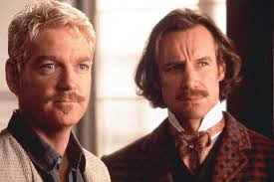
The Tragedy of Prince Hamlet
Act I Scenes IV and V
Hamlet meets Horatio on the battlements of the castle. They hear the sound of the men in the castle laughing riotously; the King draining his "draughts of Rhenish down." Hamlet explains to Horatio his dislike of such drunken behavior, which has rendered the country weak and corrupt.

Slide 34
The Tragedy of Prince Hamlet
Act I Scenes IV and V
Enter
The Ghost enters and beckons Hamlet to leave with it "as if it some impartment did desire" to Hamlet alone.
Despite the pleading of Horatio and Marcellus, who are afraid that the apparition might be an evil entity in disguise, Hamlet insists on following the Ghost.

Slide 35
The Tragedy of Prince Hamlet
Act I Scenes IV and V
Enter
The Ghost tells Hamlet that it is the spirit of his father, come from the tormenting flames of purgatory to reveal that he was poisoned by his brother, Claudius. The Ghost disappears, leaving Hamlet horrified and enraged. "O villain, villain, smiling, damned villain!"

Slide 36
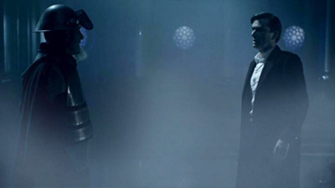
The Tragedy of Prince Hamlet
Act I Scenes IV and V
Hamlet vows to think of nothing but revenge until Claudius has suffered for his betrayal. Hamlet insists Horatio and Marcellus keep what they have seen secret and warns them that he may feign madness. Hamlet calls to his father's spirit "rest, rest,” before cursing his fate:
“The time is out of joint. O cursed spite
That ever I was born to set it right!”

