Slide 1
Words to Know and Love
Week Two

Slide 2
Literary Terms
A protagonist is the central character in a play, novel, or any other story. Although sometimes called a “hero”, a protagonist may not be heroic or admirable. The word "protagonist" comes from the ancient Greek word "protagonistes," meaning "one who plays the first part.“
In Flannery O”Connor’s “A Good Man is Hard to Find,” the grandmother is the protagonist. The first line of the story reads: “THE GRANDMOTHER didn't want to go to Florida.” Hers is the primary POV.

Slide 3
Literary Terms
An antagonist is a character or force that stands in opposition to the protagonist. The term antagonist comes from Greek word “antagonistēs” (opponent, competitor or rival.)
The protagonist struggles against the antagonist. This conflict is resolved with the defeat of the antagonist or, as in tragedies, with the downfall of the protagonist.
In “A Good Man is Hard to Find”, the Misfit is the antagonist.
"I just know you're a good man," [the grandmother] said.
“Nome, I ain't a good man," The Misfit said.

Slide 4
Words to Know and Love
Asphyxiate: to cause to die or lose consciousness by impairing normal breathing, as by gas; choke; suffocate; smother.
First known use: 1706, from Greek asphyxia "stopping of the pulse," from a- "not" + sphyzein "to throb.“
[The Grandmother] “was afraid [Pitty Sing] might brush against one of the gas burners and accidentally asphyxiate himself.”
Flannery O’Connor; “A Good Man is Hard to Find”

Slide 5
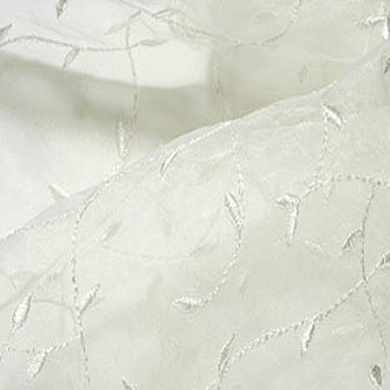
Words to Know and Love
Organdy: a fine, thin cotton fabric used for blouses, dresses, curtains, trimmings, etc.
1829, from French organdi; perhaps alteration of Organzi, from medieval form of Urgench, city in Uzbekistan that was a cotton textile center.
“Her collars and cuffs were white organdy trimmed with lace and at her neckline she had pinned a purple spray of cloth violets containing a sachet.” Flannery O’Connor; “A Good Man is Hard to Find”

Slide 6
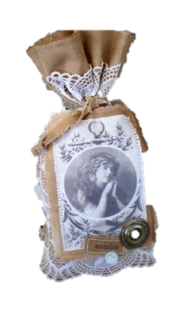
Words to Know and Love
Sachet ; noun
1. a small perfumed bag used to scent clothes.
2. dried, scented material for use in scenting clothes.
Origin: mid 19th century: from French, ‘little bag,’ from Latin saccus : ‘sack, bag.’

Slide 7
Words to Know and Love
Disposition: noun
1. a) final arrangement : settlement
b) orderly arrangement
2. a) prevailing tendency, mood, or inclination
b) temperamental makeup
Middle English, from Latin disponere to arrange
“[Bailey] didn't have a naturally sunny disposition like she [the grandmother] did and trips made him nervous.”
Flannery O’Connor; “A Good Man is Hard to Find”

Slide 8
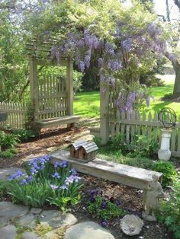
Words to Know and Love
Trellis: noun
1. a frame of latticework used as a screen or as a support for climbing plants
First Known Use: Late 14c., from Latin trilicis, "having three threads”
“ …the house had an avenue of oaks leading up to it and two little wooden trellis arbors on either side…” Flannery O’Connor; “A Good Man is Hard to Find”

Slide 9
Words to Know and Love
Bespectacled: adj
Wearing glasses (spectacles)
First Known Use: 1745 From Latin spectare "to view, watch, behold“
“The grandmother had the peculiar feeling that the bespectacled man was someone she knew. “
- Flannery O’Connor; GMHF

