Slide 1
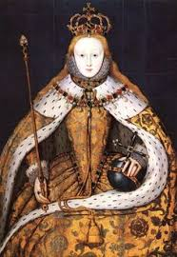
Literary Term to Know and Love
Once you have put the words in your composition books, you are responsible for knowing them. Expect surprise quizzes.

Slide 2
Literary Term to Know and Love
Metonymy: a figure of speech consisting of the use of the name of one thing for that of another of which it is an attribute or with which it is associated (as “crown” in “lands belonging to the crown”)

Slide 3
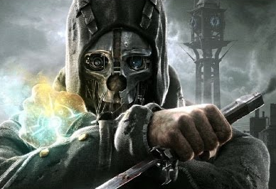
Literary Term to Know and Love
Synecdoche: a figure of speech by which a part is put for the whole (as fifty sail for fifty ships), the whole for a part (as society for high society), the species for the genus (as cutthroat for assassin), the genus for the species (as a creature for a man), or the name of the material for the thing made (as boards for stage)

Slide 4
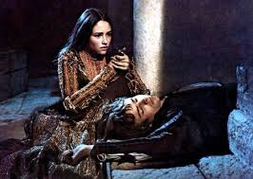
Literary Term to Know and Love
Apostrophe: The rhetorical strategy of addressing a person who is not present, an inanimate object, or an abstract concept.
"O happy dagger! This is thy sheath; there rust, and let me die." Romeo and Juliet
from Greek apostrophē, literally, act of turning away

Slide 5
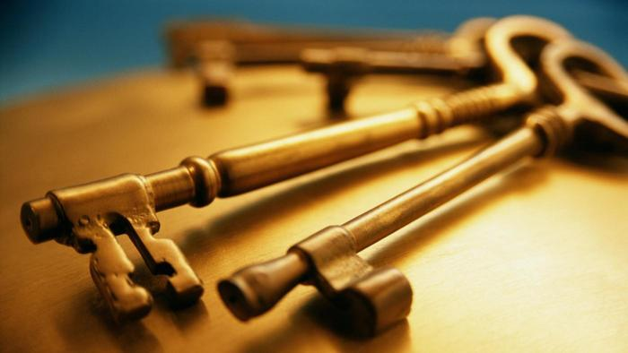
Words to Know and Love
Brazen: adj.
1. bold and without shame.
"brazen defiance"
2. made of brass.
3. harsh in sound.
"the music's brazen chords“
Old English bræsen “made of brass”

Slide 6
Words to Know and Love
Impious: adj.
1. not showing respect or reverence, especially for a god. “…the emperor's impious attacks on the Church."
synonyms: wicked, immoral, unrighteous, "an impious and terrible deed”

Slide 7
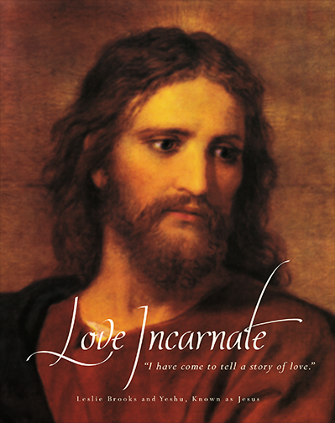
Words to Know and Love
Incarnate: adj: 1: invested with bodily and especially human nature and form
2: made manifest or comprehensible: embodied
“a fiend incarnate”
- from Latin in- + carn-, caro : “flesh”
First known use: 14th century

Slide 8
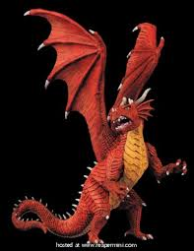
Words to Know and Love
Implacable: adj: opposed to someone or something in a very angry or determined way that cannot be changed. “An implacable foe.”
-from the Latin: im (“not”) + placare, (“to calm, soothe or please”)

Slide 9
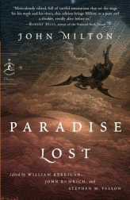
Literary Terms to Know and Love
Antithesis: is a rhetorical device in which two opposite ideas are put together in a sentence to achieve a contrasting effect in order to express an idea more emphatically.

Slide 10
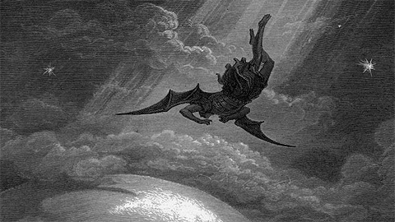
Literary Terms to Know and Love
Example: From John Milton’s Paradise Lost
“Better to reign in Hell, than serve in Heav’n.”
The contrasting ideas of “reign”/ “serve” and “Hell”/ “Heav’n” are placed in a sentence to achieve a powerful antithetical effect.

Slide 11
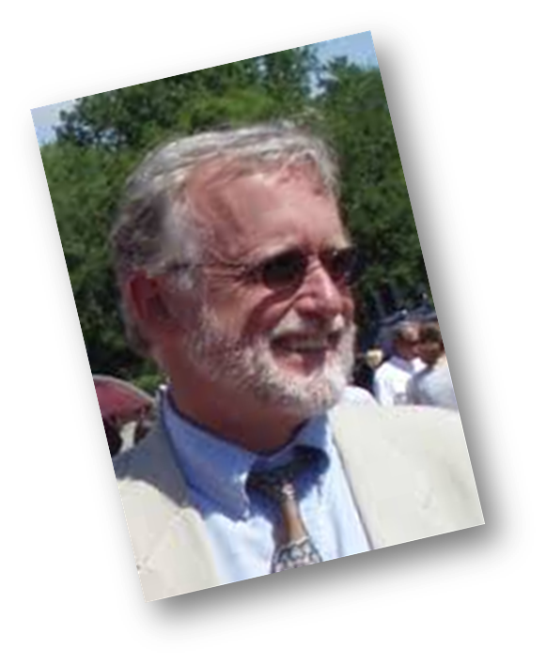
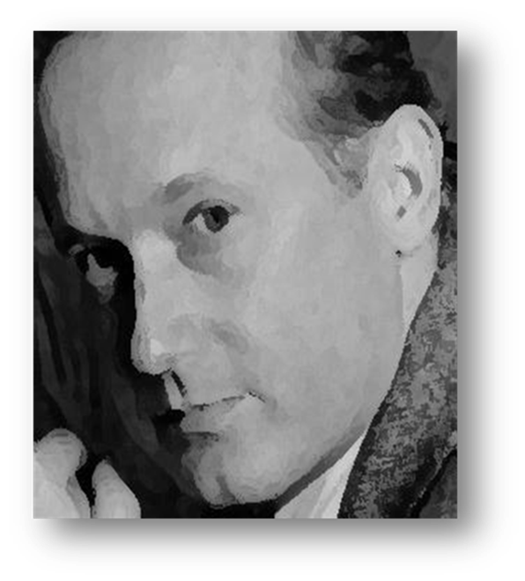
Literary Terms to Know and Love
Litotes: is a figure of speech that employs an understatement by negating the opposite of the idea being expressed.
“I’m not as young as I used to be.” (I’m old.). “He’s no hero.” (He’s a coward.)

